Slide 1

CAP615 PROGRAMMING IN JAVA
Unit-2

Slide 2
Collection Framework topics covered:
ArrayList class,
ListIterator interface,
Linkedlist class,
TreeSet class,
PriorityQueue class,
comparable and comparator,
Properties class,
Lambda expressions

Slide 3
Collection
group of individual objects.
Student S1=new
Student()
S1
S2
S3
S4
S5
S6

Slide 4
Collection framework
Several classes and interfaces which can be used
a group of objects.
Package: util
import java.util.*;

Slide 5
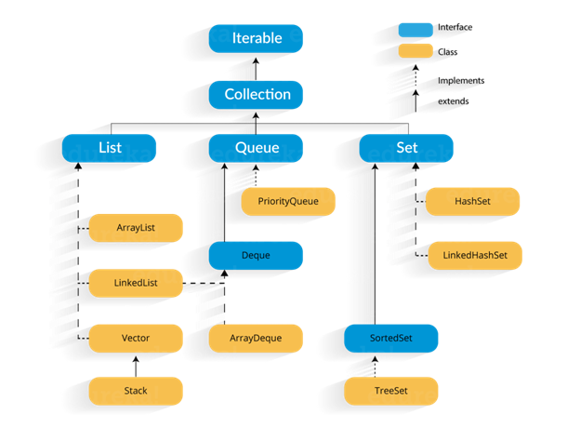

Slide 6
Keyword: extends and implements
Used in case of inheritance:
Class to class- extends
(class classA extends classB)
Interface to interface: extends
interface I1 extends I2
Class to interface: implements
(class classA implements interfaceA)

Slide 7
ArrayList class
ArrayList class uses a concept of dynamic array for storing the elements.
It is like an array, with no size limit. We can add or remove elements anytime.
It is found in the java.util package
ArrayList class can contain duplicate elements also.

Slide 8
ArrayList al=new ArrayList();
//creating old non-generic arraylist
ArrayList<String> al=new ArrayList<String>();
//creating new generic arraylist
Java new generic collection allows you to have only one type of object in a collection. Now it is type safe so typecasting is not required at runtime.

Slide 9
Methods in ArrayList:
Add():
Add new elements to an ArrayList using the add() method.
Syntax:
arrayListObj.add(arrayListElement)
Ex:
List.add(“java”)
2. Adding an element at a particular index in an ArrayList.
Syntax:
arrayListObj.add(arrayListIndex, arrayListElement)
Ex:
List.add(2, “java”)

Slide 10
3. size():
to find the size of an ArrayList using the size() method.
Syntax:
arrayListObj.size()
Ex:
List.size()
4. get():
access the element at a particular index in an ArrayList using the get() method.
Syntax:
arrayListObj.get(0)
Ex:
List.get(0)

Slide 11
5. Set():
to modify the element at a particular index in an ArrayList using the set() method.
Syntax:
arrayListObj.set(index,element)
Ex:
List.set(4, “java”)
6. isEmpty():
To check if an ArrayList is empty using the isEmpty() method.
It will return true or false
List.isEmpty()

Slide 12
7. contains():
This method returns true if this list contains the specified element.
Ex:
boolean retval = arrlist.contains(10);
8. remove():
to remove the element at a given index in an ArrayList
Syntax:
arrayListObj.remove(int index)
9. removeAll():
to remove all the elements from an ArrayList.

Slide 13
10. indexOf():
The indexOf() method of ArrayList returns the index of the first occurrence of the specified element in this list, or -1 if this list does not contain the element.

Slide 14
Iterator interface
Iterator is an interface that iterates the elements.
Iterator can traverse elements in a collection only in forward direction.
It is used to traverse the list and modify the elements. Iterator interface has three methods:
public boolean hasNext() – This method returns true if the iterator has more elements.
public object next() – It returns the element and moves the cursor pointer to the next element.
public void remove() – This method removes the last elements returned by the iterator.

Slide 15
ListIterator
ListIterator is an interface in a Collection framework, and it extends the Iterator interface.
Using ListIterator, you can traverse the elements of the collection in both forward and backwards directions.

Slide 16
public class JavaIteratorExample {
public static void main(String[] args)
{
ArrayList<String> cityNames = new ArrayList<String>();
cityNames.add("Delhi");
cityNames.add("Mumbai");
cityNames.add("Kolkata");
cityNames.add("Chandigarh");
cityNames.add("Noida");
// Iterator to iterate the cityNames
Iterator iterator = cityNames.iterator();
System.out.println("CityNames elements : ");
while (iterator.hasNext())
System.out.print(iterator.next() + " ");
System.out.println();
}
}

Slide 17
Methods in ListIterator
boolean hasNext( ): It returns true if the list has a next element.
boolean hasPrevious( ): It returns true if the list has a previous element.
next( ): It returns the next element of the list. It throws ‘NoSuchElementException’ if there is no next element in the list.
previous( ): It returns the previous element of the list. It throws ‘NoSuchElementException’ if there is no previous element.
void remove( ): It removes the current element from the list. It throws ‘IllegalStateException’ if this function is called before next( ) or previous( ) is invoked.

Slide 18
Linkedlist class
LinkedList class uses a doubly linked list to store the elements.
Methods:
void addFirst(E e) | It is used to insert the given element at the beginning of a list.
void addLast(E e) | It is used to append the given element to the end of a list.
getFirst() | It is used to return the first element in a list.
getLast() | It is used to return the last element in a list.

Slide 19
Linkedlist class
peek() | It retrieves the first element of a list
peekFirst() | It retrieves the first element of a list or returns null if a list is empty.
peekLast() | It retrieves the last element of a list or returns null if a list is empty.
poll() | It retrieves and removes the first element of a list.
pollFirst() | It retrieves and removes the first element of a list, or returns null if a list is empty.
pollLast() | It retrieves and removes the last element of a list, or returns null if a list is empty.
pop() | It pops an element from the stack represented by a list.
void push(E e) | It pushes an element onto the stack represented by a list.
remove() | It is used to retrieve and removes the first element of a list.
remove(int index) | It is used to remove the element at the specified position in a list.

Slide 20
TreeSet class
TreeSet class implements the Set interface that uses a tree for storage.
The objects of the TreeSet class are stored in ascending order.
Java TreeSet class contains unique elements means does not allow duplicate elements
Java TreeSet class doesn't allow null element

Slide 21
Methods of TreeSet class:
add(Object o): This method will add the specified element according to the same sorting order mentioned during the creation of the TreeSet.
addAll(Collection c): This method will add all elements of the specified Collection to the set. Elements in the Collection should be homogeneous
clear(): This method will remove all the elements.
contains(Object o): This method will return true if a given element is present in TreeSet else it will return false.
first(): This method will return the first element in TreeSet if TreeSet is not null else it will throw NoSuchElementException.
last(): This method will return the last element in TreeSet if TreeSet is not null else it will throw NoSuchElementException.
size(): This method is used to return the size of the set or the number of elements present in the set.

Slide 22
import java.util.*;
public class Main
{
public static void main(String[] args)
{
TreeSet<String> t1=new TreeSet<String>();
t1.add("Kumar");
t1.add("Vishal");
t1.add("Rahul");
t1.add("Abhinav");
t1.add("Vishal");
for(String str:t1)
{
System.out.println(str);
}
}
}

Slide 23
PriorityQueue Class
A PriorityQueue is used when the objects are supposed to be processed based on the priority. It is known that a Queue follows the First-In-First-Out algorithm.
Operations on PriorityQueue:
Adding Elements: In order to add an element in a priority queue, we can use the add() method.
Removing Elements: In order to remove an element from a priority queue, we can use the remove() method.
Accessing the elements: Since Queue follows the First In First Out principle, we can access only the head of the queue.
Iterating the PriorityQueue: There are multiple ways to iterate through the PriorityQueue. The most famous way is converting the queue to the array and traversing using the for loop.

Slide 24
Example:
PriorityQueue<String> pq = new PriorityQueue<>();
pq.add("Samsung");
pq.add("Nokia");
pq.add("RealMe");
Iterator iterator = pq.iterator();
while (iterator.hasNext())
{
System.out.print(iterator.next() + " ");
}

Slide 25
class PriorityQueueDemo { // Main Method public static void main(String args[]) { // Creating empty priority queue PriorityQueue<Integer> pQueue = new PriorityQueue<Integer>(); // Adding items to the pQueue using add() pQueue.add(10); pQueue.add(20); pQueue.add(15); // Printing the top element of PriorityQueue System.out.println(pQueue.peek()); // Printing the top element and removing it // from the PriorityQueue container System.out.println(pQueue.poll()); // Printing the top element again System.out.println(pQueue.peek()); } }
Output
10
10
15

Slide 26
Comparable and Comparator
Comparable and Comparator both are interfaces and can be used to sort collection elements.

Slide 27
Comparable | Comparator
1) Comparable provides a single sorting sequence. In other words, we can sort the collection on the basis of a single element such as id, name, and price. | The Comparator provides multiple sorting sequences. In other words, we can sort the collection on the basis of multiple elements such as id, name, and price etc.
2) Comparable provides compareTo() method to sort elements. | Comparator provides compare() method to sort elements.
3) Comparable is present in java.lang package. | A Comparator is present in the java.util package.

Slide 28
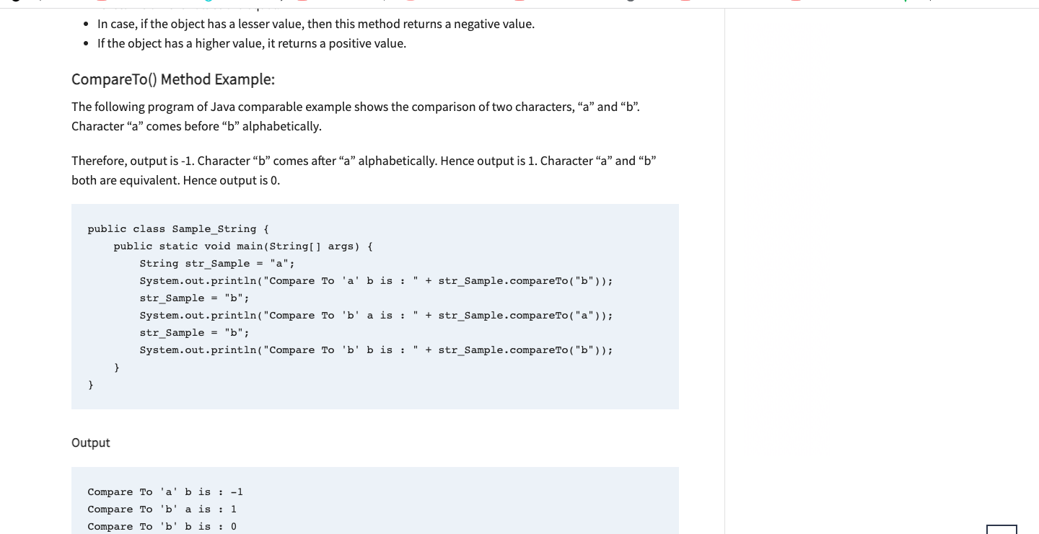
Type to enter a caption.

Slide 29
import java.util.*;
import java.io.*;
class Student implements Comparable<Student>{
int rollno;
String name;
int age;
Student(int rollno,String name,int age){
this.rollno=rollno;
this.name=name;
this.age=age;
}
public int compareTo(Student st){
if(age==st.age)
return 0;
else if(age>st.age)
return 1;
else
return -1;
}
}
compareTo method is
used to sort the elements
of the list

Slide 30
public class TestSort3{
public static void main(String args[]){
ArrayList<Student> al=new ArrayList<Student>();
al.add(new Student(101,"Vijay",23));
al.add(new Student(106,"Ajay",27));
al.add(new Student(105,"Jai",21));
Collections.sort(al);
for(Student st:al){
System.out.println(st.rollno+" "+st.name+" "+st.age);
}
}
}

Slide 31
class Student{
int rollno;
String name;
int age;
Student(int rollno,String name,int age){
this.rollno=rollno;
this.name=name;
this.age=age;
}
}

Slide 32
import java.util.*;
class AgeComparator implements Comparator<Student>{
public int compare(Student s1,Student s2){
if(s1.age==s2.age)
return 0;
else if(s1.age>s2.age)
return 1;
else
return -1;
}
}

Slide 33
import java.util.*;
import java.io.*;
class TestComparator{
public static void main(String args[]){
//Creating a list of students
ArrayList<Student> al=new ArrayList<Student>();
al.add(new Student(10,"Amit",23));
al.add(new Student(16,"Ajay",27));
al.add(new Student(15,"Jatin",21));
System.out.println("Sorting by Name");
//Using NameComparator to sort the elements
Collections.sort(al,new NameComparator());
//Traversing the elements of list
for(Student st: al){
System.out.println(st.rollno+" "+st.name+" "+st.age);
}
System.out.println("sorting by Age");
//Using AgeComparator to sort the elements
Collections.sort(al,new AgeComparator());
//Travering the list again
for(Student st: al){
System.out.println(st.rollno+" "+st.name+" "+st.age); } } }

Slide 34
Properties class in Java
The properties object contains key and value pair both as a string.
An Advantage of the properties file
Recompilation is not required if the information is changed from a properties file: If any information is changed from the properties file, you don't need to recompile the java class.

Slide 35
*******************************************************************************/
import java.util.*;
import java.io.*;
public class Main {
public static void main(String[] args)throws Exception{
Properties p=new Properties();
p.setProperty("Name","Prince Arora");
p.setProperty("email","princearorabca@gmail.com");
p.store(new FileWriter("info.properties"),"Java Properties Example");
}
}

Slide 36
Lambda expressions
In programming, a Lambda expression (or function) is just an anonymous function, i.e., a function with no name
The Lambda expression is used to provide the implementation of an functional interface ,we don't need to define the method again for providing the implementation.
Note: An interface which has only one abstract method is called functional interface.

Slide 37
Lambda Expression Syntax
(argument-list) -> {body};
1) Argument-list: It can be empty or non-empty
2) Arrow-token: It is used to link arguments-list and body of expression.
3) Body: It contains expressions and statements for lambda expression.

Slide 38
interface Drawable{
public void draw();
}
public class LambdaExpressionExample {
public static void main(String[] args) {
int width=10;
//without lambda, Drawable implementation using anonymous class
Drawable d=new Drawable(){
public void draw(){System.out.println("Drawing "+width);}
};
d.draw();
}
}

Slide 39
interface Drawable{
public void draw();
}
public class LambdaExpressionExample2 {
public static void main(String[] args) {
int width=10;
//with lambda
Drawable d2=()->{
System.out.println("Drawing "+width);
};
d2.draw();
}
}

Slide 40
interface printable{
void print();
}
class A6 implements printable{
public void print(){System.out.println("Hello");}
public static void main(String args[]){
A6 obj = new A6();
obj.print();
}
}

Slide 41



